Slide 1
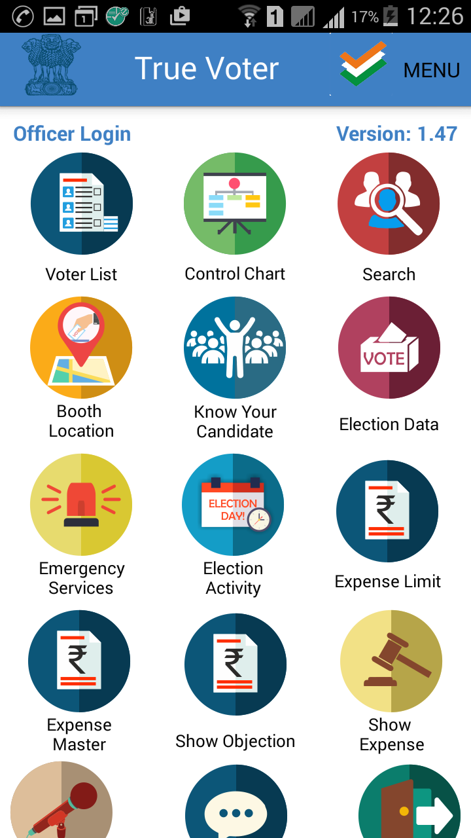
True Voter version 1.47
Home page for officer user.
In officer role user has following functionalities:-
1)Voter List.
2)Control chart.
3)Search
4)Booth location
5)Know your candidate
6)Election data
7)Emergency Services
8)Election Activity
9)Expense Limit
10)Expense Master
11) show Objection
12)Show Expense
13)My vision
14)Feedback
15)Logout.

Slide 2
True Voter version 1.47
Voter List:-
By using this function user can download the the list of voter for particular ward number.
To use this function user should be logged in the officer role.
Officer user can download the list of candidates for particular ward.

Slide 3
True Voter version 1.47
Control chart:-
This function is available only for officer user.
By using this function officer user can prepare the list of voters as per the Ac no., part no., ward no and the status of voter.
In this function officer user have to enter data from the field location.

Slide 4
True Voter version 1.47
Search function:-
Using this function user can find his name in the voter list.
If user is registred voter, then he can search his name in the voter list.
This function is available for both visitor user and registred user.

Slide 5
True Voter version 1.47
Booth Location:-
Only officer user can access this function.
In this function officer user can capture the booth location.
Officer user have to go on the booth and perform this function to capture the location.
Officer user will capture the location and upload it on the server.
This will make usefull to voter user to find out the booth location from his mobile phone.

Slide 6
True Voter version 1.47
Know Your Candidate(KYC):-
By using this function officer user can get download the list of candidates for a particular ward.

Slide 7
True Voter version 1.47
Election Data:-
By using this function offcer can keep entry for the voting count.
On the day of election from the starting of voting till the end of voting, officer user can fill the count of voters in this function.
After every two hours user have to submit the count of voters.
This will help to find out the percentages of total voting.

Slide 8
True Voter version 1.47
Emergency Services:-
This function is usefull to officer user, when threre is any emergency at the booth on the day of election.
Officer who is on duty at booth can request for help in emergency by using this function.

Slide 9
True Voter version 1.47
Election Activity:-
This function will help to officer user to prepare the booth.
On the day of election officer can keep updates about the preparation of booth.

Slide 10
True Voter version 1.47
Expense Limit:-
This function is available only for SEC officer.
By using this function SEC officer can Enter the Limit of expense.
Depend on the type of municipal council SEC officer can enter the expense limit.

Slide 11
True Voter version 1.47
Expense Master:-
This function is available only for Collector officer.
By using this function collector user can prepare the expense master for the district.
In this function collector user will define the standard rates for the different expenses related to the election for the candidate.
The standard rates entered by collector user will be displyed to candidate user when candidate user fill the daily expense.
The standard rates entered by collector officer will be applicable for the all the candidates of that particular district.

Slide 12
True Voter version 1.47
Show objection:-
By using this function Officer user can view the objections taken on the expense of candidate by voter and other candidates.
Officer will get the list of candidate’s expense on which objection has raised by others.

Slide 13
True Voter version 1.47
Show Expense:-
User can view the expense entered by the candidate.
By using this function user can download the list of candidate’s for particular ward.
After that user can download the expense for particular candidate.

Slide 14
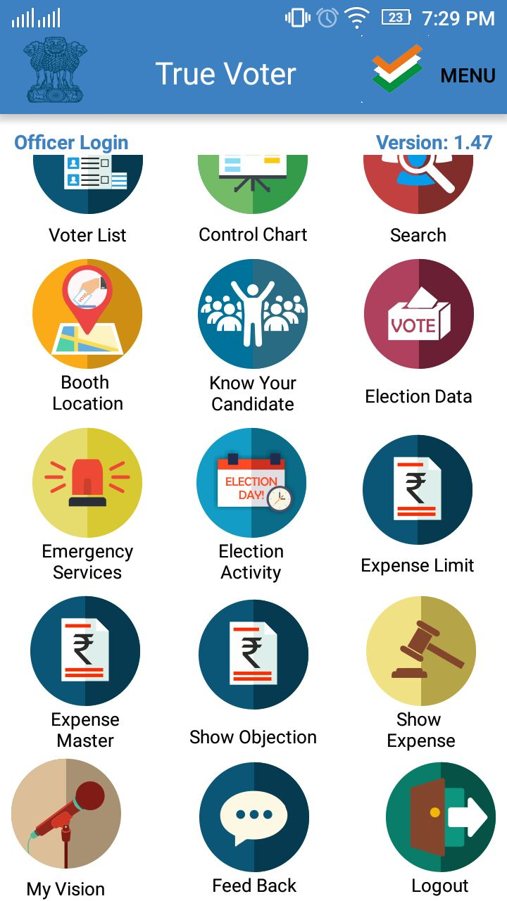
True Voter version 1.47
My Vision:-
Officer user does not access this function.
This function is available only for Candidate user.

Slide 15
True Voter version 1.47
Feedback:-.
This function is available for all kinds of users.
By using this function a user can submit his feedback here.
The feedback can be submit into three types are:
1)Demand
2)Suggestion
3)Complaint
If user has any issue regarding application can use the ‘Call for help’ function.

Slide 16
True Voter version 1.47
Logout function:-
To logout from application user can use ‘Logout’ function.

